Slide 1

VRTRAVELLER (A Virtual History Simulation)
Group Members
Abdul Wasey (19P-0113)
Ammaar Ahmed Khan (19P-0016)
Mohammad Junaid (19P-0025)
Project Supervisor
Mr. Zeshan Khan

Slide 2
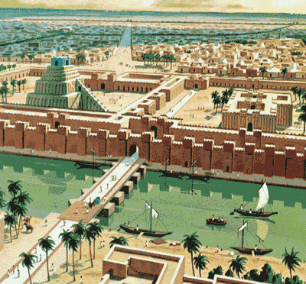
Introduction / Idea
Recreate History using VR:
Teach genesis of modern world
Teach the significance of human civilization
Revolutionize industry of tourism

Slide 3
Expected Results
FYP I
Gathering Data
Asset Creation
Historical Data Collection
Environment Prototype
FYP II
Asset Creation
Interactive Menu
Historical Relevance to Architecture
Making NPC's Intelligent
Deploying on Oculus

Slide 4
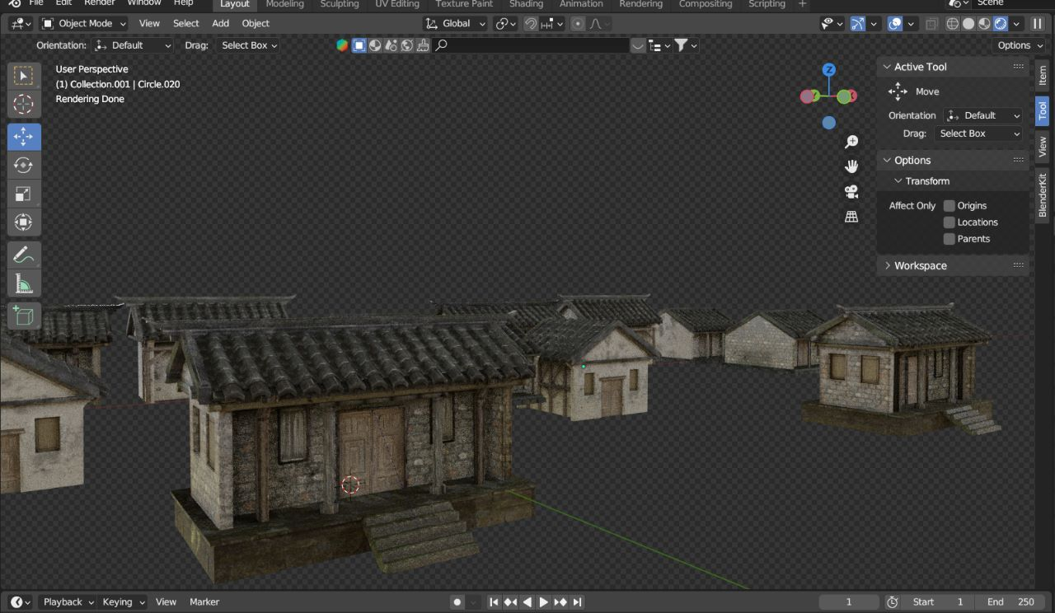
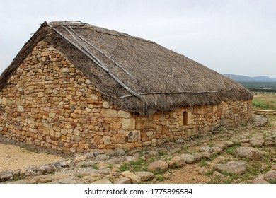

Results Achieved
Asset Creation
VERSION_1

Slide 5
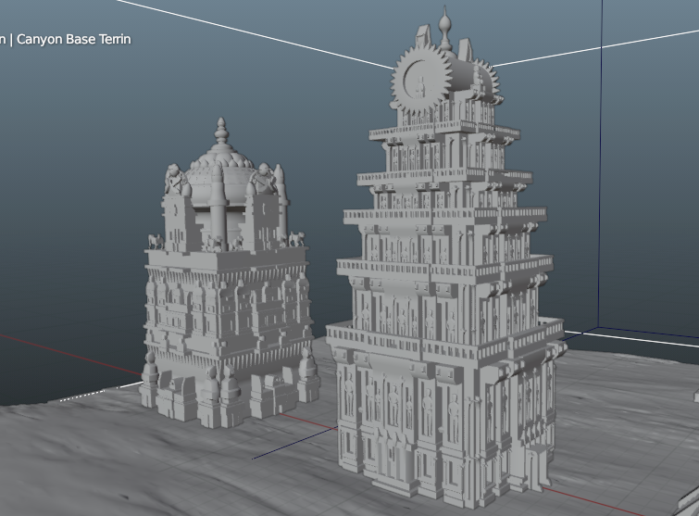
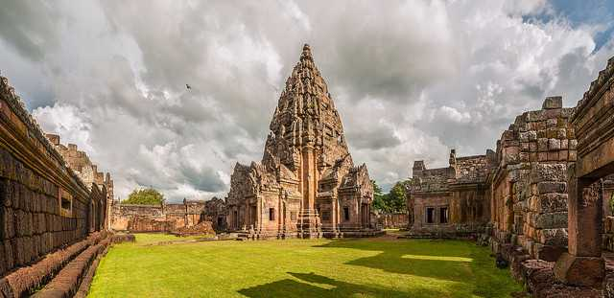
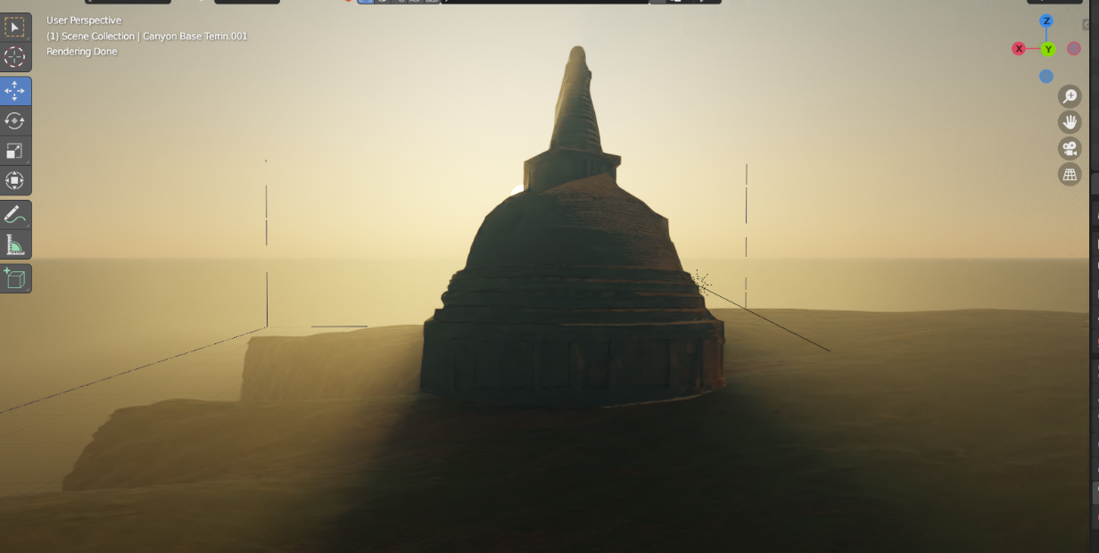
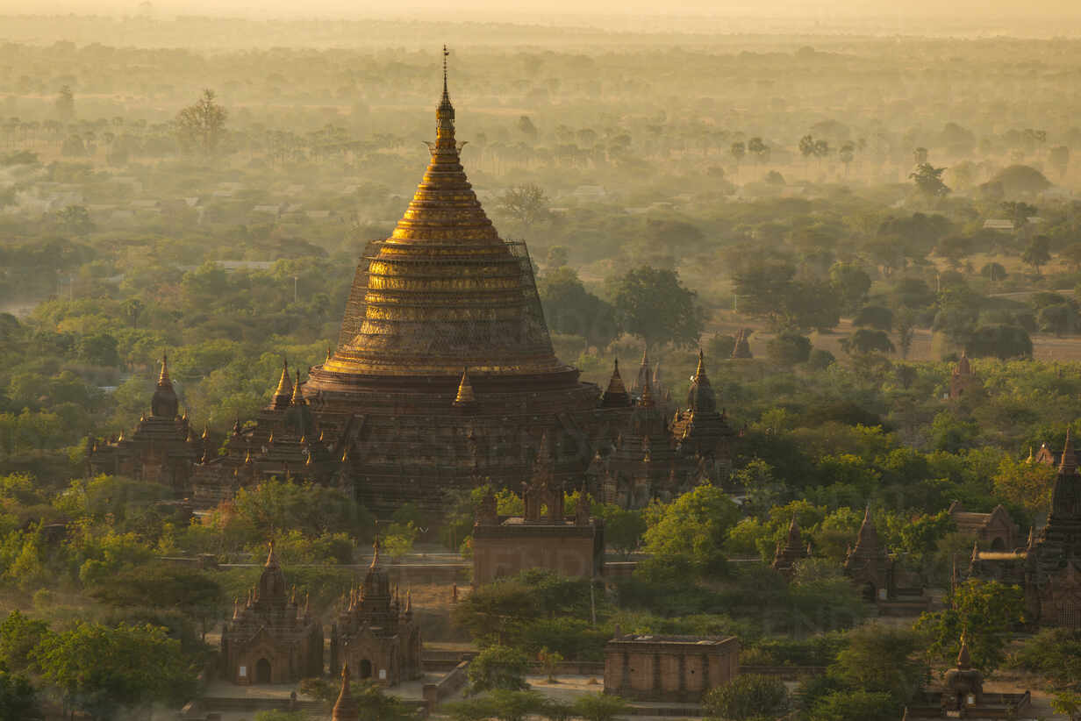
VERSION_2

Slide 6
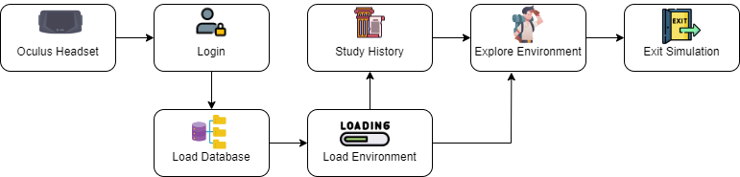
System Diagram

Slide 7
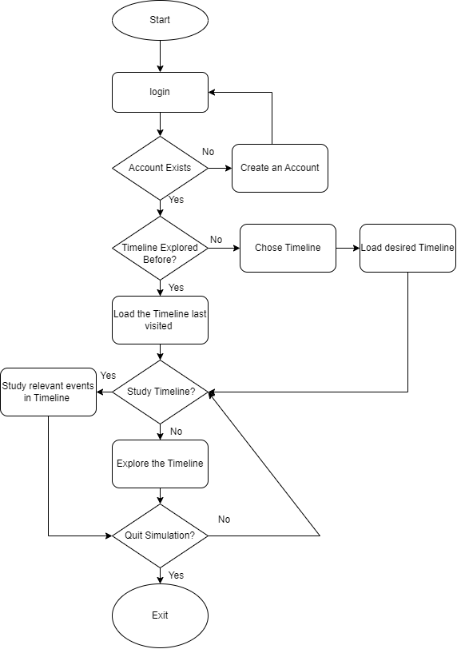
Flowchart Diagram

Slide 8
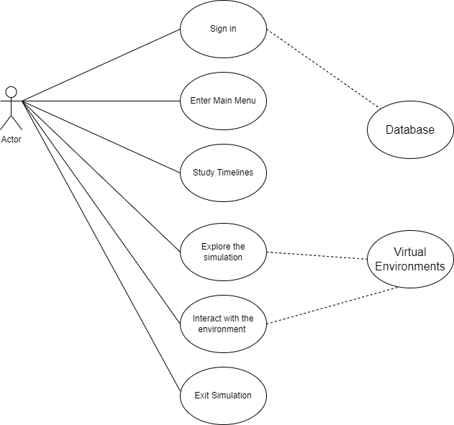
Use Case Diagram

Slide 9
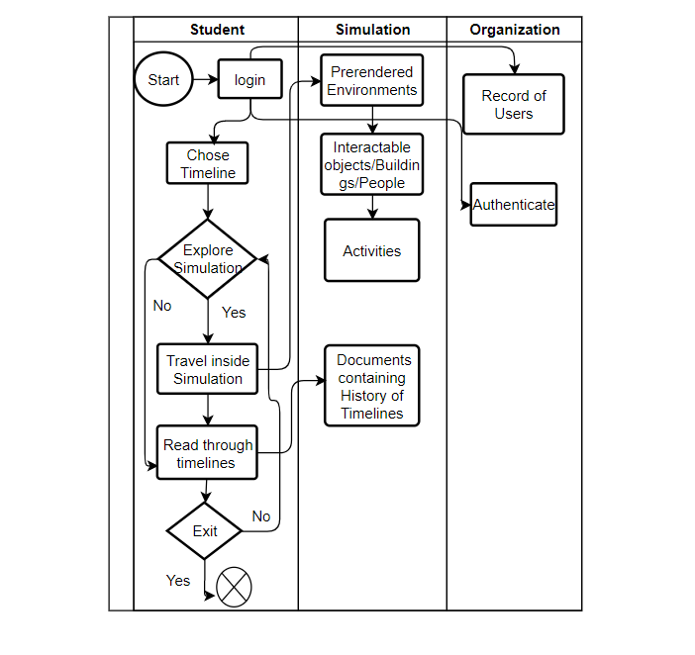
Swimlane Diagram

Slide 10
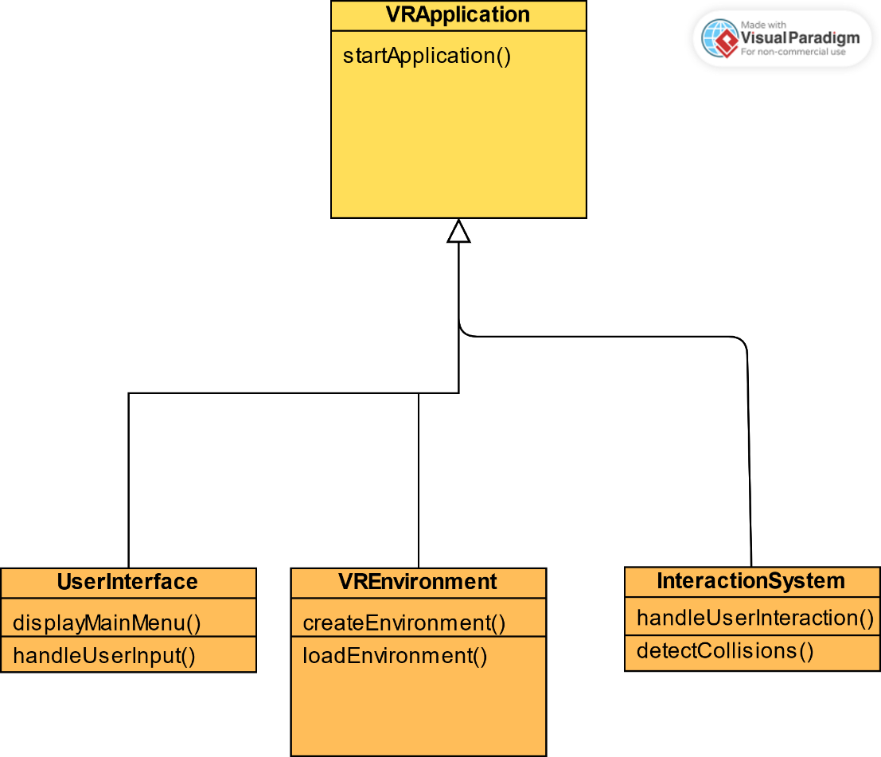
Class Diagram

Slide 11
Current Results

Slide 12
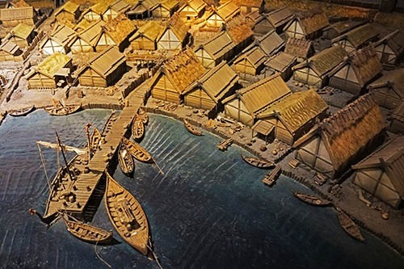
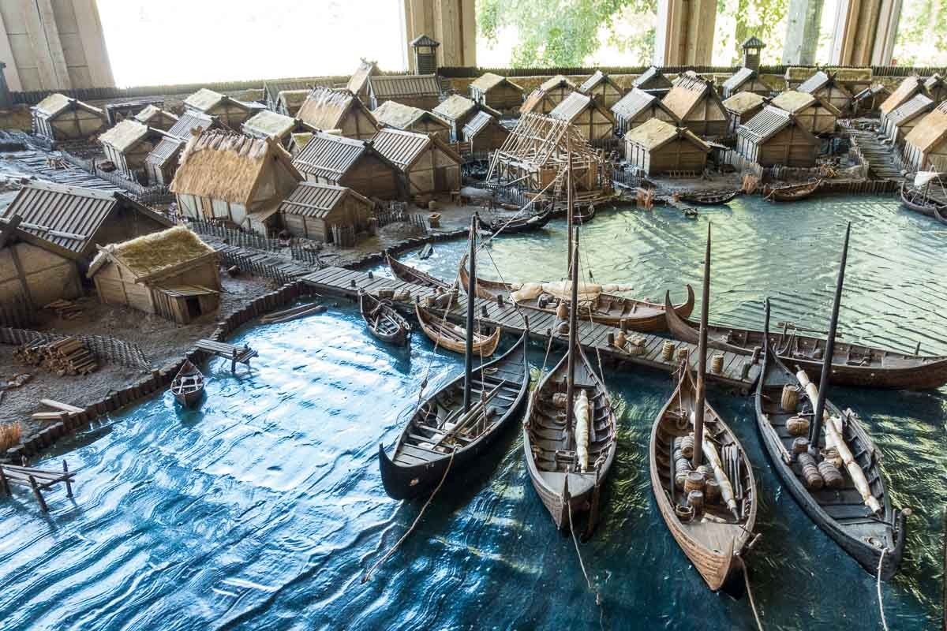
Birka

Slide 13
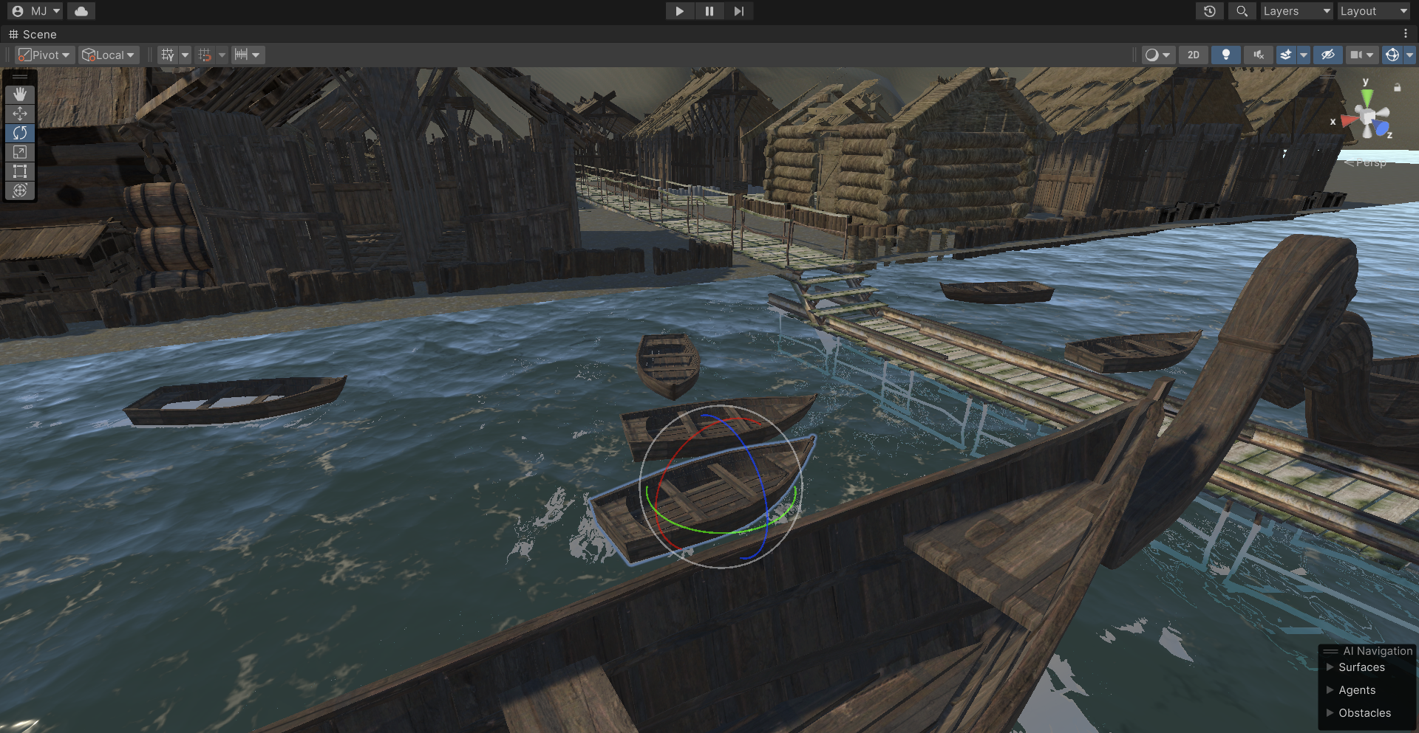

Slide 14
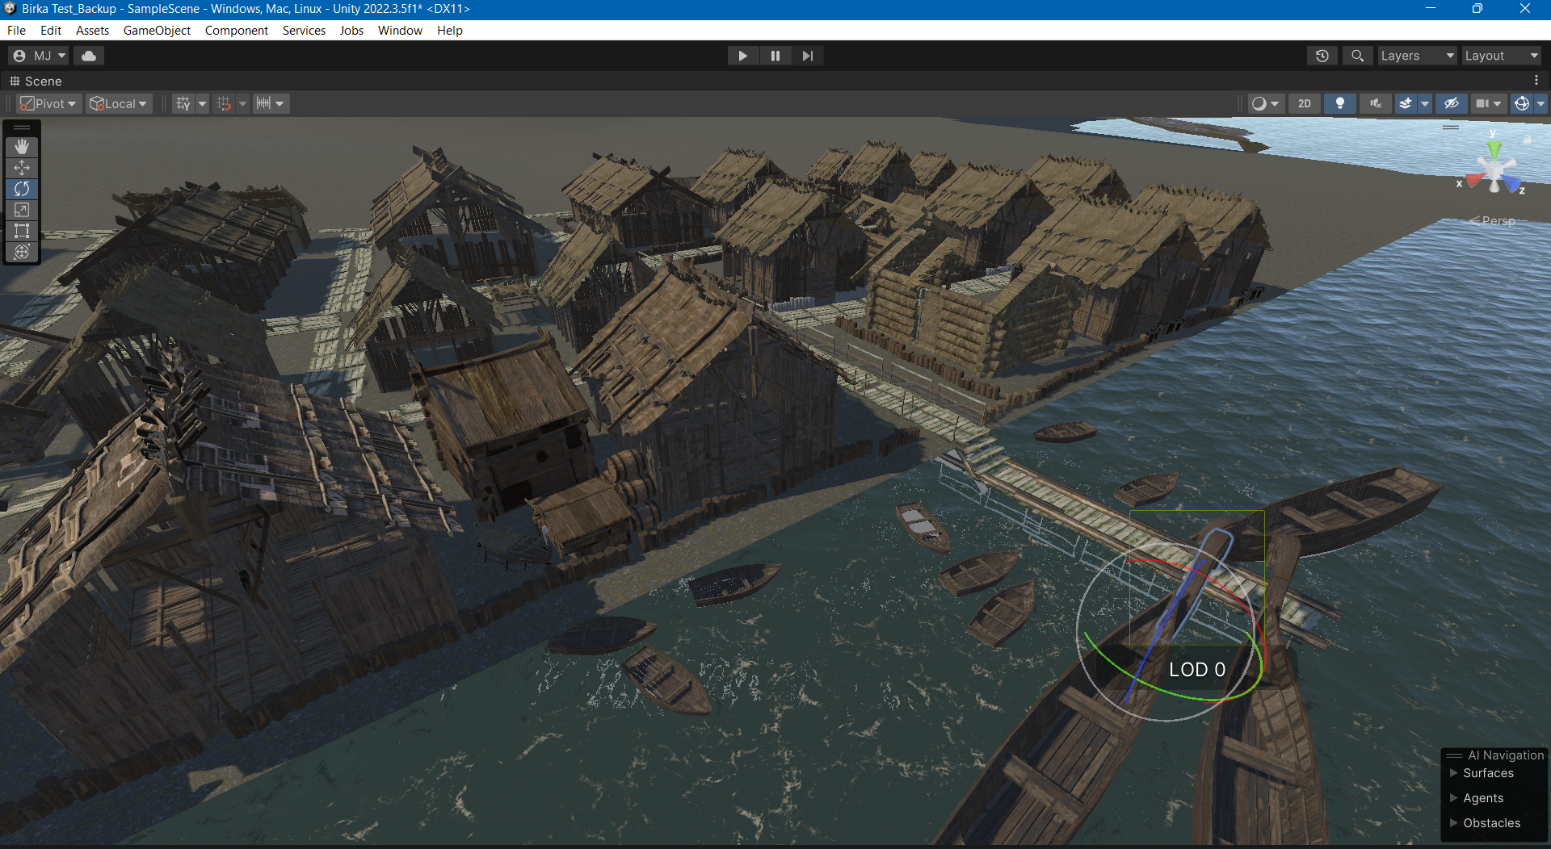

Slide 15
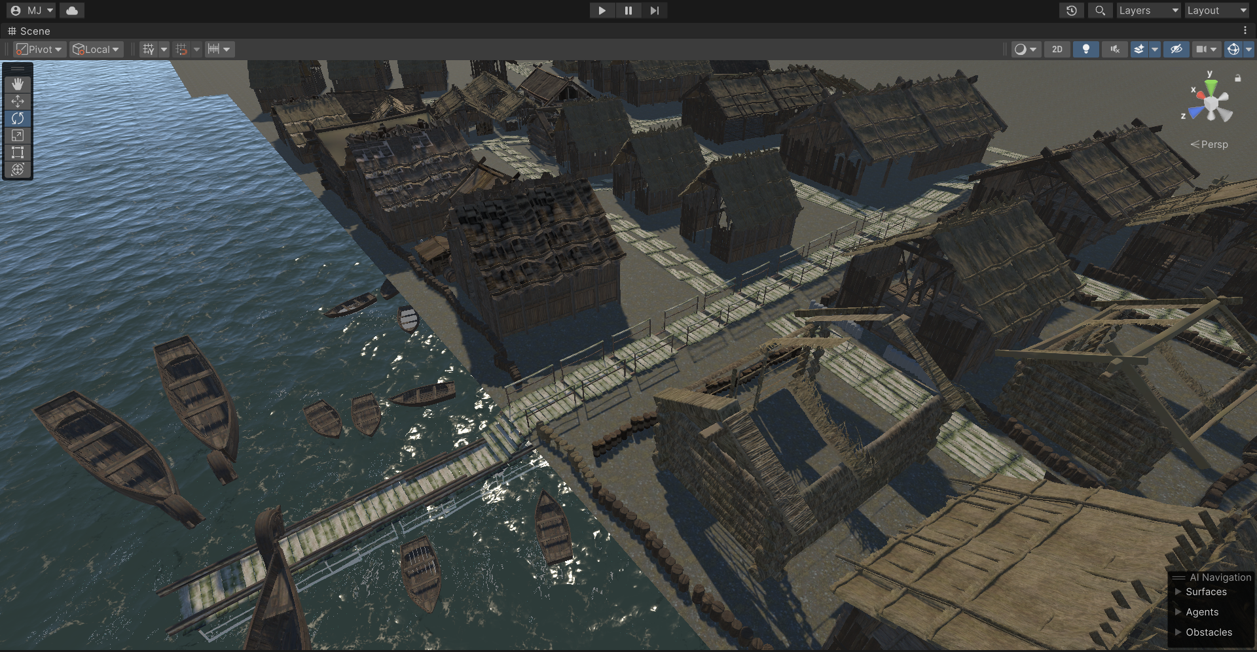

Slide 16
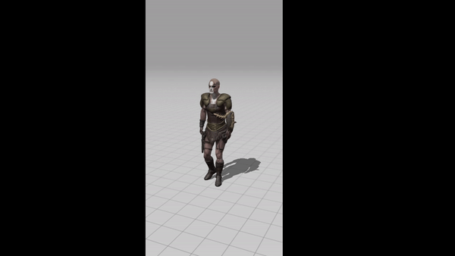
Working Animation

Slide 17
Timeline

Slide 18
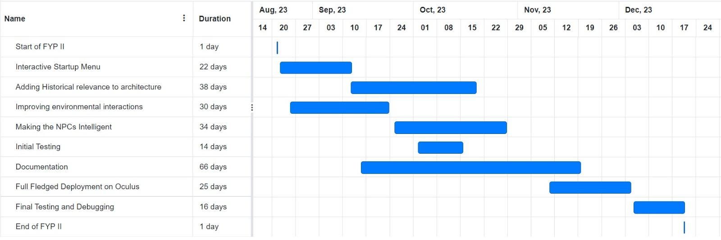
FYP 2 Gantt Chart

Slide 19
Thank you for listening !
Any Questions?

